Slide 1

Project Title – CREDIT CARD WEEKLY STATUS REPORT
SHARVANI PANDILLA]

Slide 2

PROBLEM STATEMENT
Power Bi report that provides a comprehensive overview of credit card transactions and performance metrics for previous week. The report should display
Total transactions and total value
Geographic distribution
Average creditcard balance

Slide 3
Project Description To develop a comprehensive credit card weekly dashboard that provides real-time insights into key performance metrics and trends, enabling stakeholders to monitor and analyze credit card operations effectively

Slide 4

WHO ARE THE END USERS?
Credit card Company executives
Risk management team
Marketing team
Data analysts
Portfolio managers

Slide 5

Technology Used
Power bi Desktop
Power Bi service
Data Sources
Dax (Data Analysis Expressions)
SQL
Azure

Slide 6
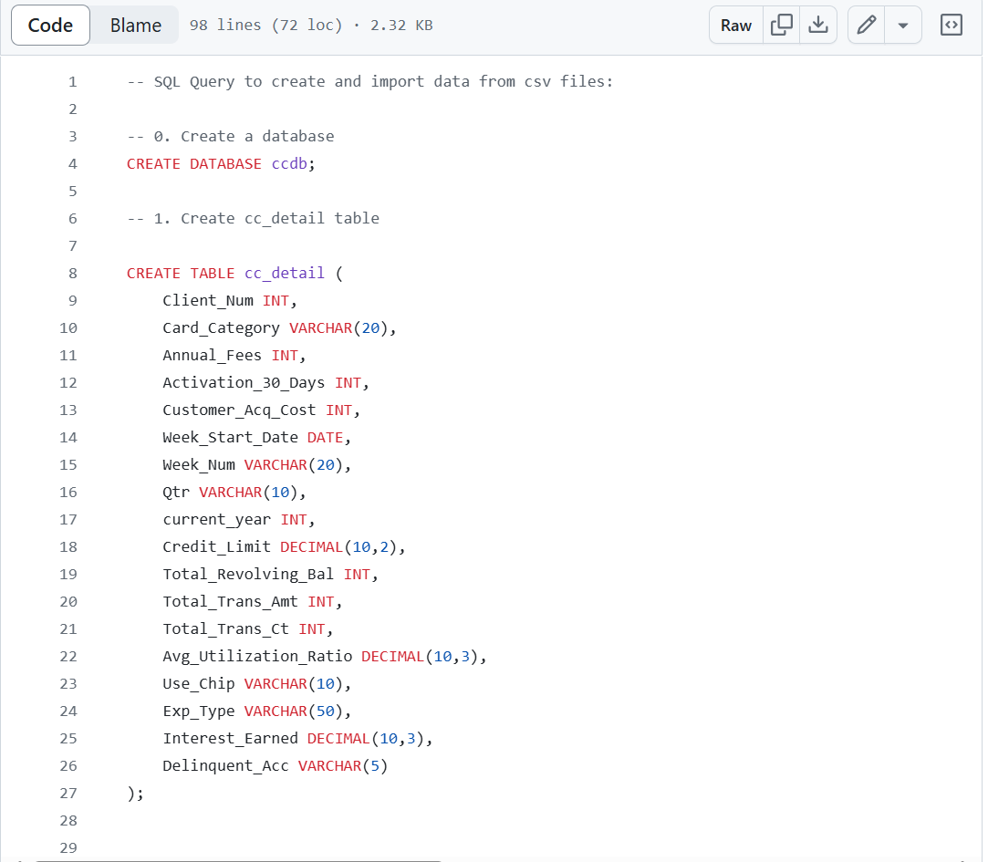
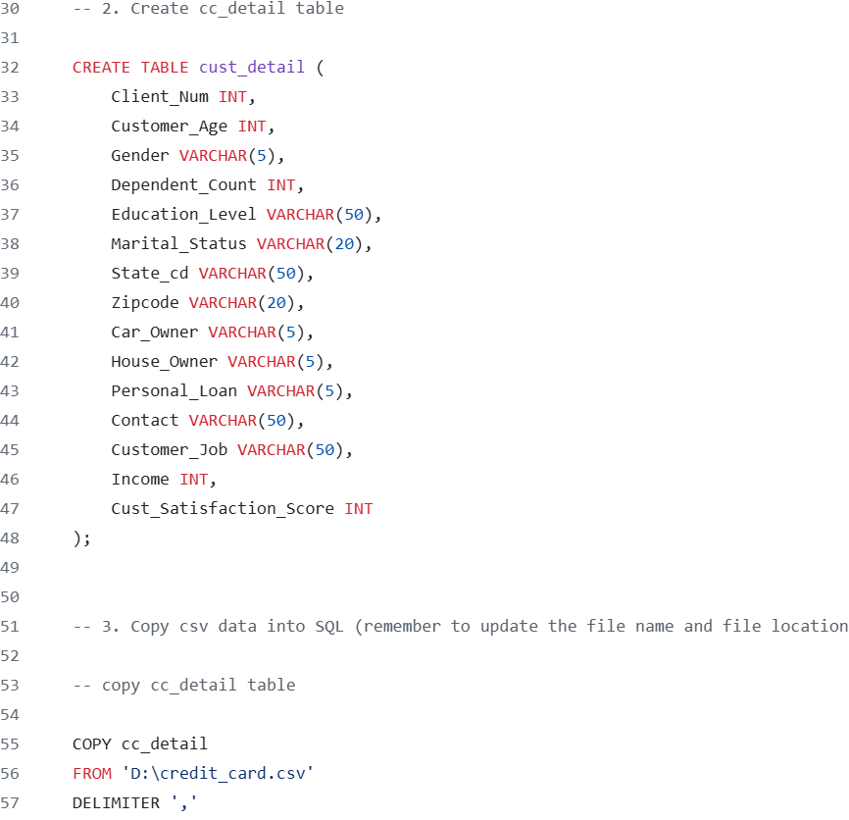
RESULTS
Demo Link

Slide 7
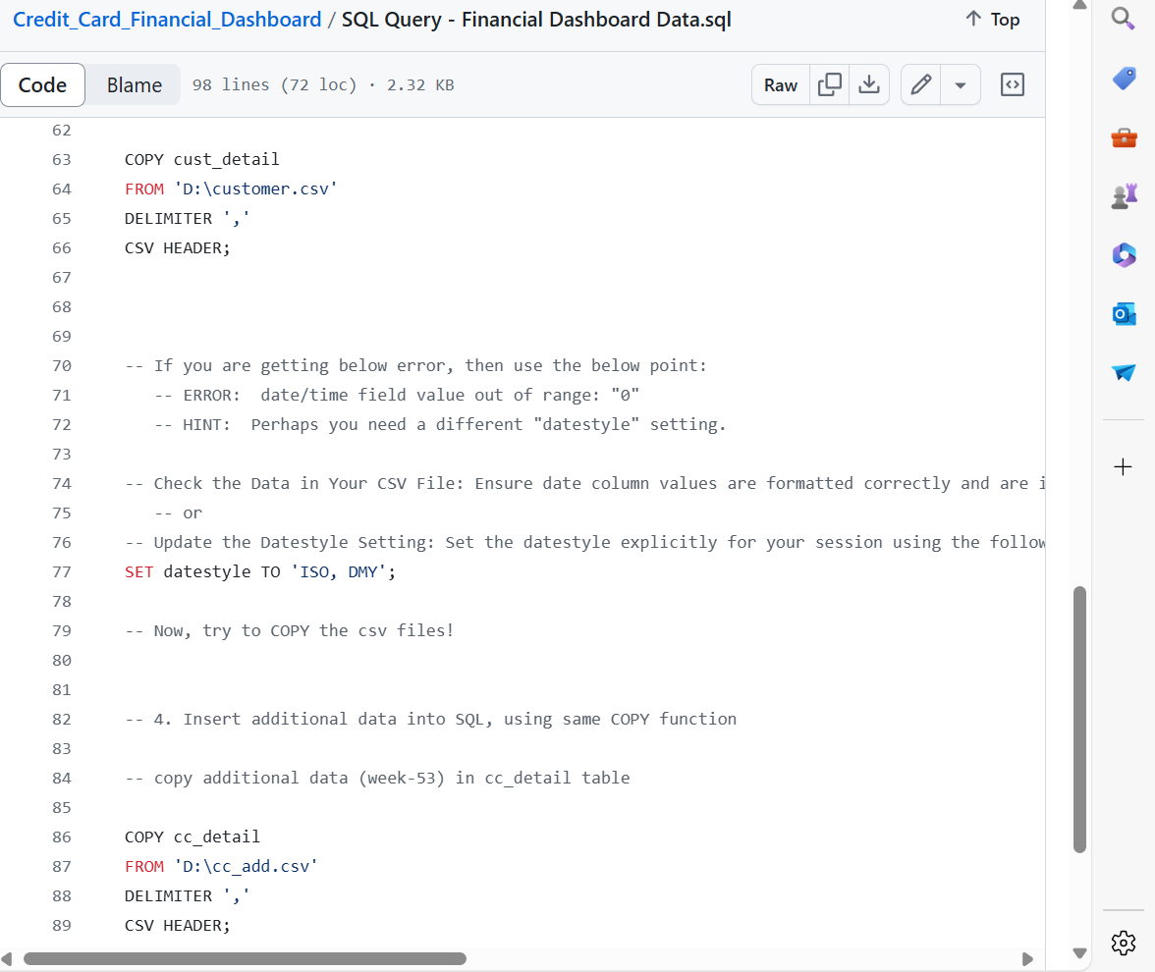
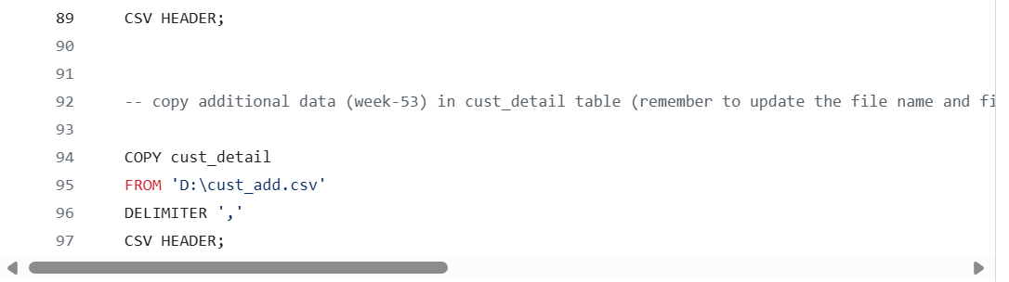

Slide 8
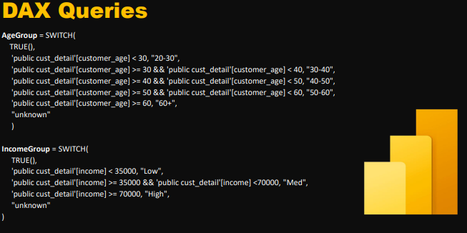
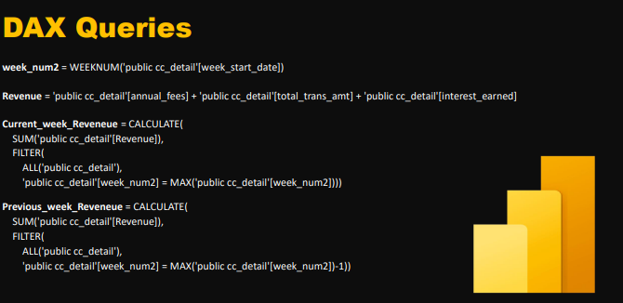

Slide 9
Thank you
.
.
Sharvani pandilla

